Slide 1

Creating new site using Toolz

Slide 2
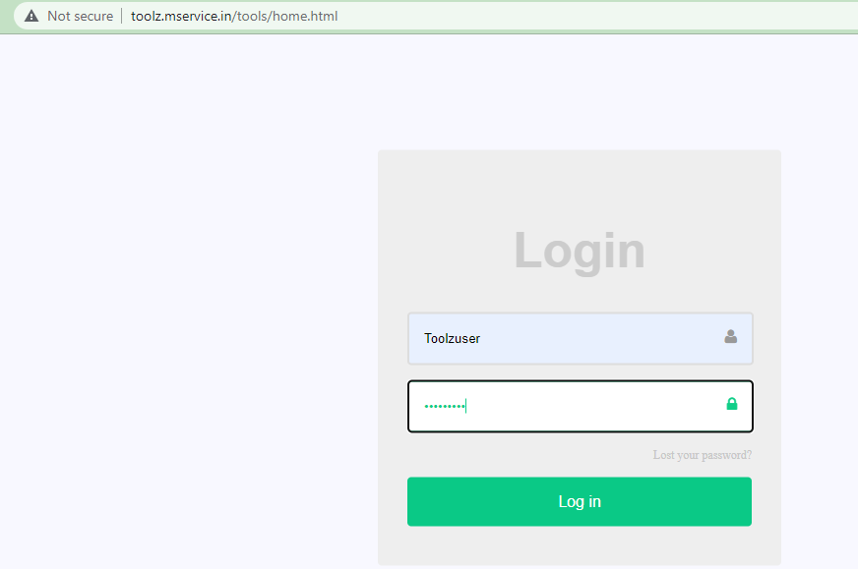
Build Website using Toolz
URL - http://toolz.mservice.in/tools/home.html
Username- Toolzuser, Password- Toolzpass

Slide 3
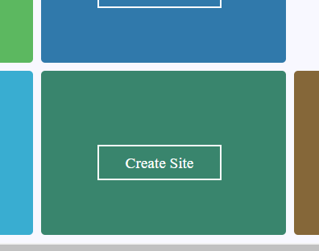
Goto Create Site

Slide 4
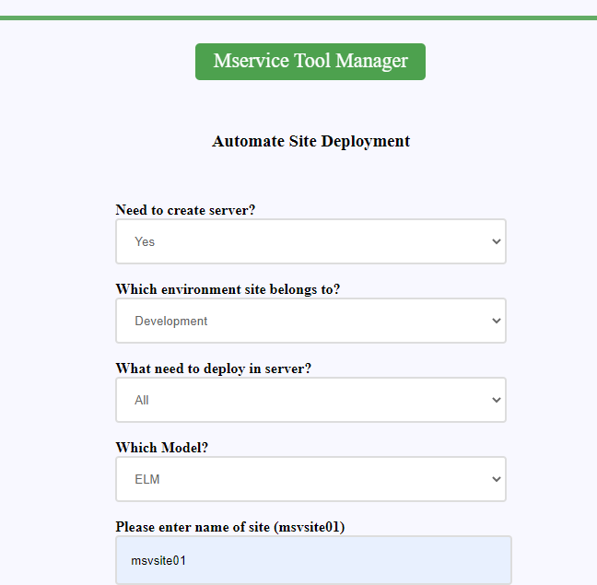

Slide 5
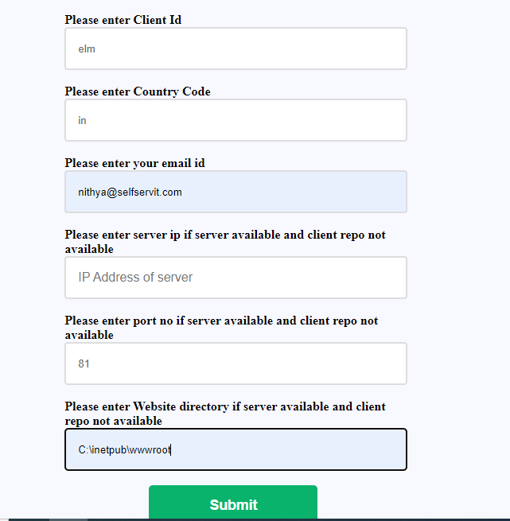

Slide 6
Need to create server ?
Yes -create site in new server
No - create site in exsisting server (need to know IP of server, availability of port and site name)
Which Enviroment? - select a environmnet from below
Development
User Acceptance Testing
Customer UAT
Integrating Testing
Product Testing
Demo Training
Unit Testing
What need to deploy - ALL
Model - select the required model
Direct
In-Direct
Smart
ELM
Site name - eg: msvsite01
Clinet id - eg: elm (max length 8 char )
Country code - eg :in
Email id- site URL will be send to given Email id
IP address to be entered only, if site creating on existing server
Port no 81 for new server . need to know the available port when creating site on existing site
Website directory- C:\inetpub\wwwroot

Slide 7
Thank You
www.mservice.net; www.mservice.ai
Chennai: HO
Flat no 3C, Door 55, Shivanantham Apt,
Pulla Avenue, Shenoy Nagar, Chennai- 600030
Ph- +91-97910-42632
Hyderabad
307 B, 3 rd floor, Block “A”
AMSRI SHAMIRA building
Building No. 9-1-113 to 118,
Old Lancer Lines,
SECUNDERABAD-500025
Bangalore
3262/1, 1st Floor, 13th Cross
2nd Stage, Indira Nagar,
Bangalore – 38
Ph - +91-88840-49883

